Slide 1
Red Flags in Emails
Phishing awareness training

Slide 2
Introduction
Definition: Phishing is a type of cyberattack where attackers impersonate trusted entities to steal sensitive information (e.g., passwords, credit card numbers).
Purpose: Understand how phishing works, how to recognize it, and how to protect yourself.
🛑 Example: You receive an email claiming to be from your bank asking you to verify your account by clicking a suspicious link.

Slide 3
Recognizing Phishing Emails
| Clue | Description
| 📧 **Generic Greetings** | “Dear Customer” instead of your name
| 🚨 **Urgency or Threats** | “Act Now or Your Account Will Be Closed”
| 🔗 **Suspicious Links** | Hover reveals a mismatched URL
| 🧾 **Unexpected Attachments** | Especially .exe, .scr, .zip
| 🔤 **Spelling/Grammar Errors** | Poor language often used by attackers

Slide 4
Spotting Fake Websites
Tactics Used:
Misspelled URLs (paypaI.com instead of paypal.com)
No HTTPS (🔒 missing)
Lookalike logos and design
Login forms asking for unusual info (SSN, full passwords)
🧠 Tip: Always type URLs manually or use bookmarks.

Slide 5



Real-World Examples
2016 Google Docs Phishing – fake invitation emails tricked users into giving access to their accounts.
COVID-19 Themed Attacks – fake health updates from WHO or CDC used to lure victims.
Workplace Examples – fake emails from “CEO” asking for urgent wire transfers.

Slide 6
Best Practices to Stay Safe
🔐 Don't click suspicious links or attachments
👁 Hover over links before clicking
🧠 Think before you act – verify with the sender
💬 Report suspicious emails to IT/security team
📱 Use MFA (Multi-Factor Authentication)
🔄 Keep software updated

Slide 7
Final Tips & Resources
🔐 Use password managers
🧠 Stay alert for new phishing techniques
📘 Visit: https://phishing.org, https://staysafeonline.org
📧 Report phishing emails to: security@[yourcompany].com

Slide 8
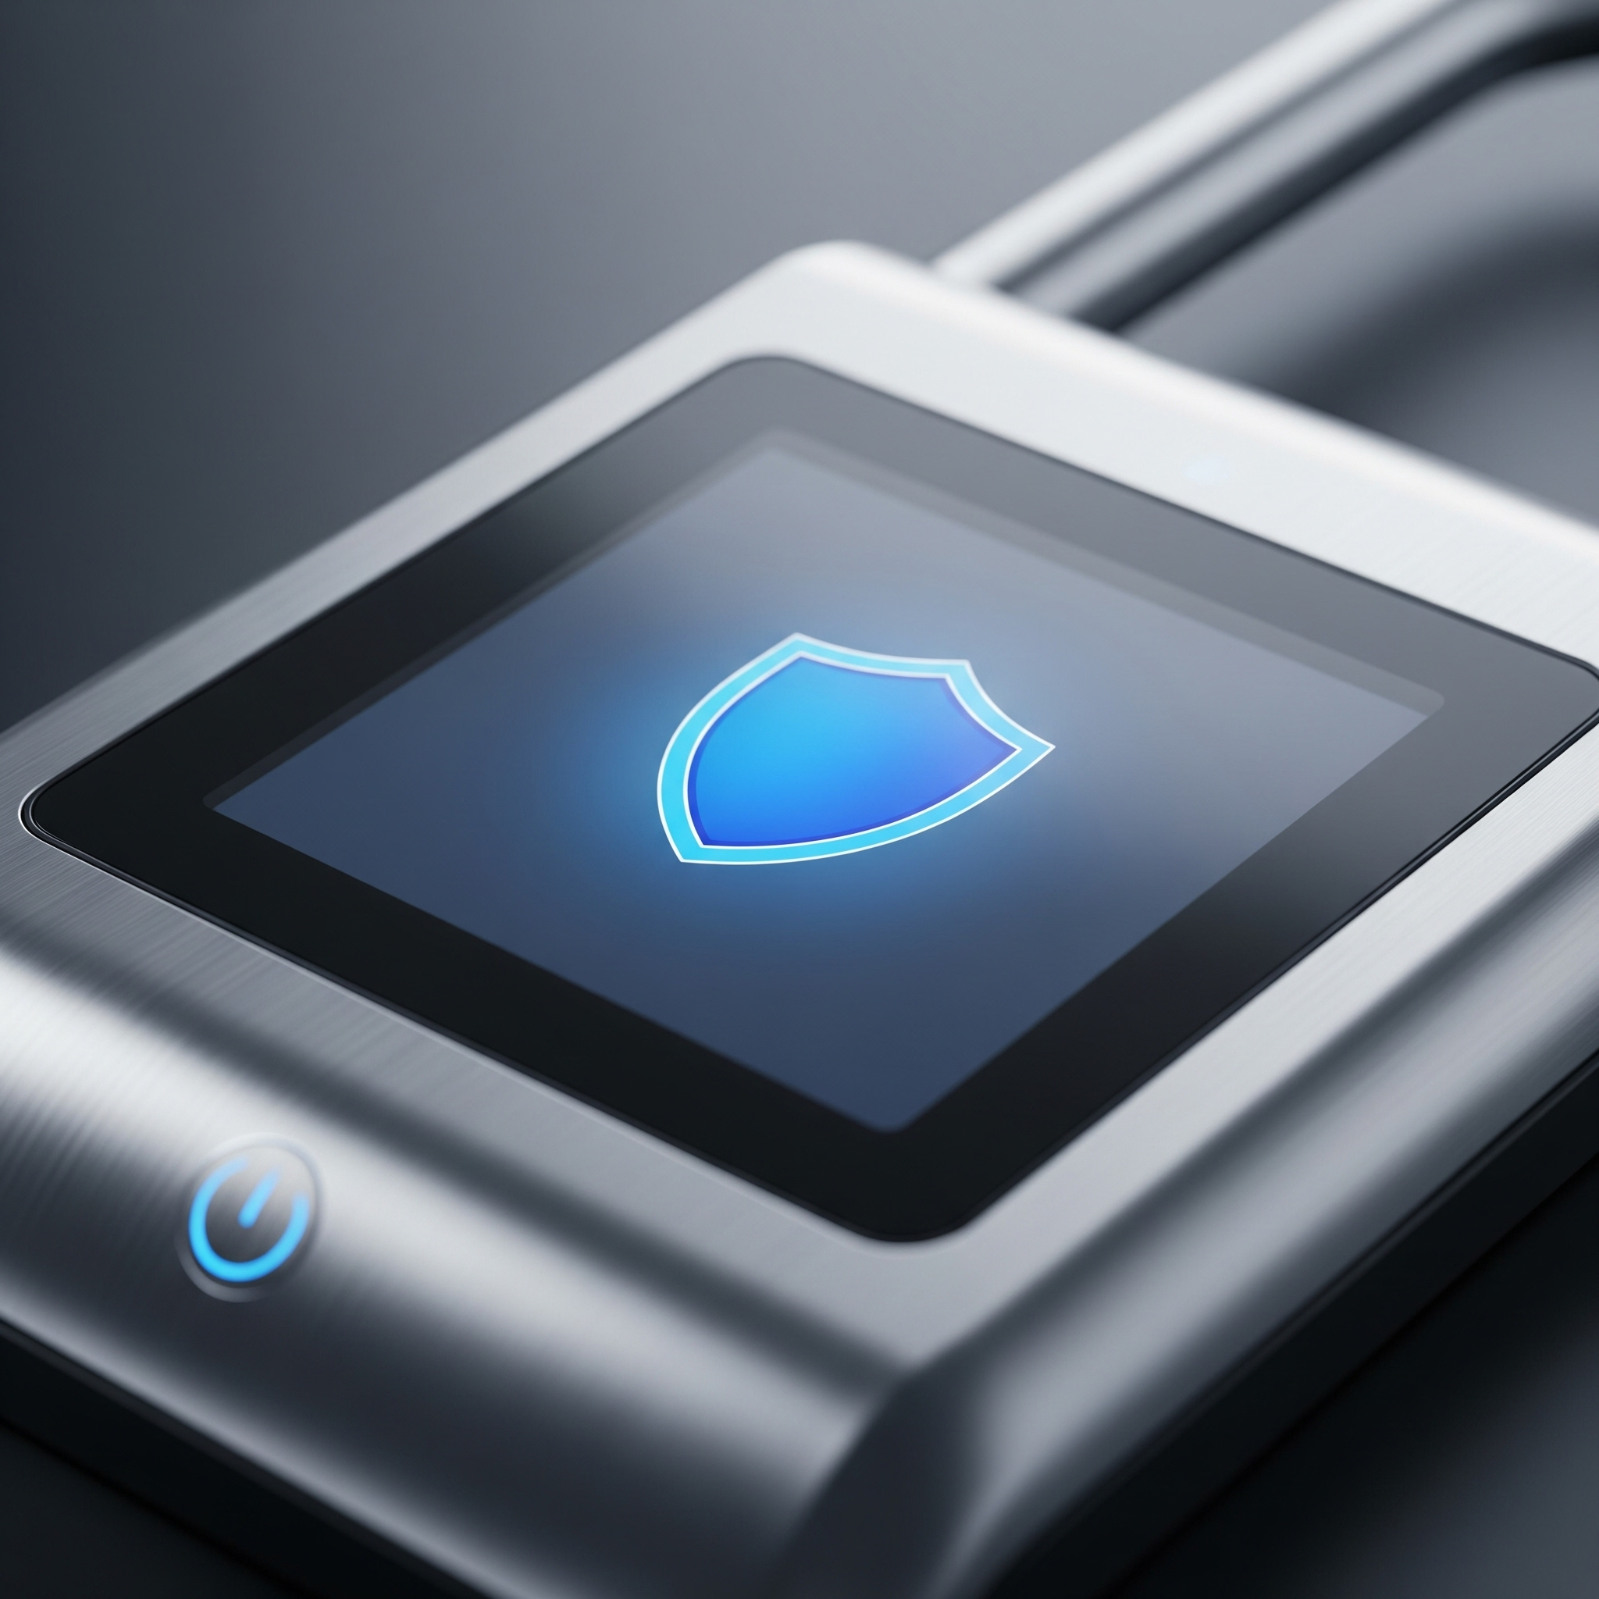
Key Takeaways & Summary
Phishing is a cyberattack to steal sensitive information
Recognize phishing by generic greetings and urgency
Spot fake websites through misspelled URLs and no HTTPS
Don't click suspicious links or attachments
Use MFA and keep software updated

Slide 9

Thank You!
Thank you for your time and attention
Your participation is greatly appreciated
Stay vigilant and secure online
Report any suspicious activity immediately

